Slide 1

Analyzing Chest X-Rays Using Machine Learning
Justin Grisanti

Slide 2
Objectives – 5 Step Model
Obtain a Business Understanding
Understand the Data
Prepare Data for Modeling
Create Models
Generate Results

Slide 3
Business Understanding
Stakeholders:
Hospital Patients with Pneumonia
Doctors from Mount Sinai
Business Problem
Pneumonia ranks second to congestive heart failure as the reason for hospital readmission within 30 days of a previous hospitalization
Goals/Value-add
To reduce the number of readmissions due to missed cases of pneumonia
Radiologists
Mount Sinai has contracted me to use deep learning to more accurately predict whether a patient has pneumonia, given a patient’s chest x-ray
To provide Mount Sinai with a model that can more accurately classify a patient’s chest x-ray

Slide 4
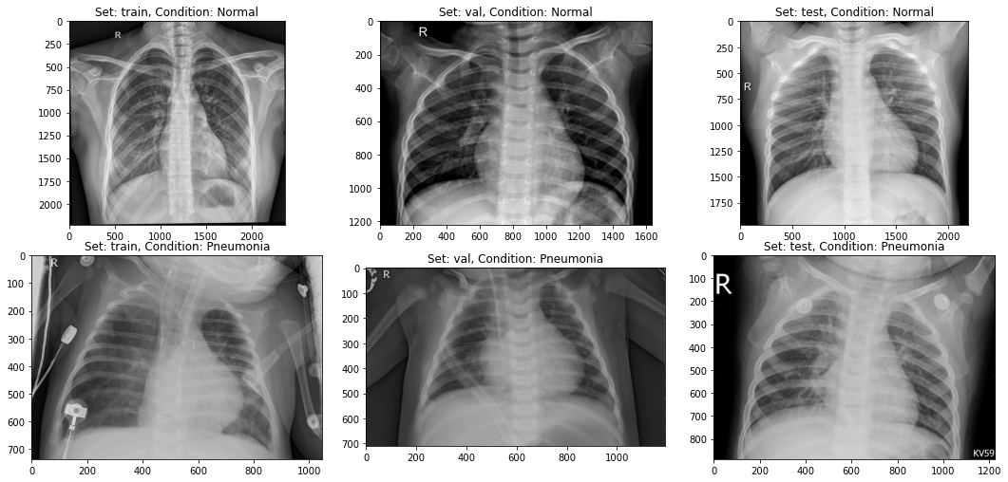
Data Understanding
Notes:
6k chest x-rays

Slide 5
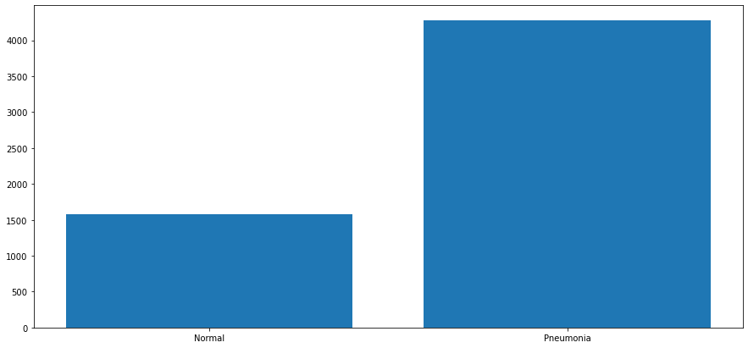
Data Understanding
Notes:
73% class 1; 27% is class 0

Slide 6
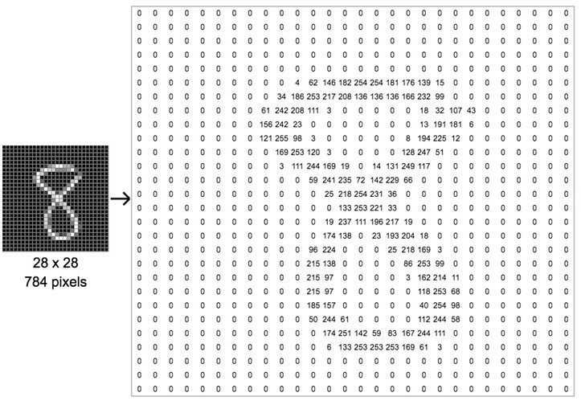
Data Preparation
Using preprocessing techniques to convert an image from a picture to an array of numbers that our computer can read

Slide 7
Modeling
Redefine the Problem
Patients are readmitted due to doctors’ failure to diagnose pneumonia
Modeling Solution
Our model should minimize false negatives (Type II error)
False Negatives: Patients diagnosed as not having pneumonia when they actually have pneumonia
Using Recall to minimize Type II error
Image Classification using Keras

Slide 8
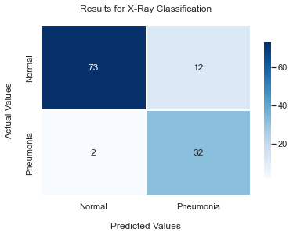
Best Model Results
Best Model: 94% Recall Score
Patient has Pneumonia:
Correctly classified that the patient has pneumonia 94% of the time
Patient doesn’t have Pneumonia :
Correctly classified that the patient doesn’t have pneumonia 86% of the time
Value: Model prevents False Negatives 88% of the time
Notes:
Used hold-out validation data to predict

Slide 9
Next Steps:
Introduce more data
Try a new set of models

Slide 10

Thank You For Your Time!

